Slide 1
Lightning talk 4: Design
sddec24-16
Cameron Jones, Blake Hardy, Cayden Kelley, Chase O’Connell, Holden Brown, Tejal Devshetwar

Slide 2
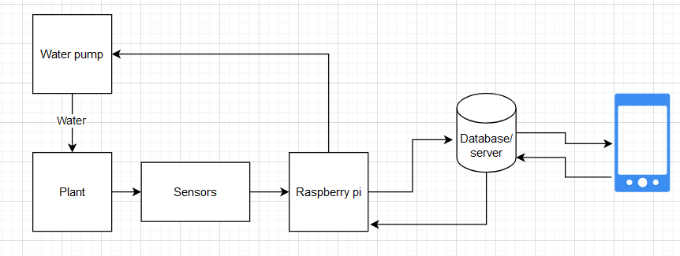
Project Overview
Create a device that automatically collects soil data (NPK,moisture,temperature).
Sends the data to a database on a server.
Create a phone app which presents the collected data of a users soil.
Server has logic that sends commands to automatically water/fertilize plants when certain conditions are met.

Slide 3
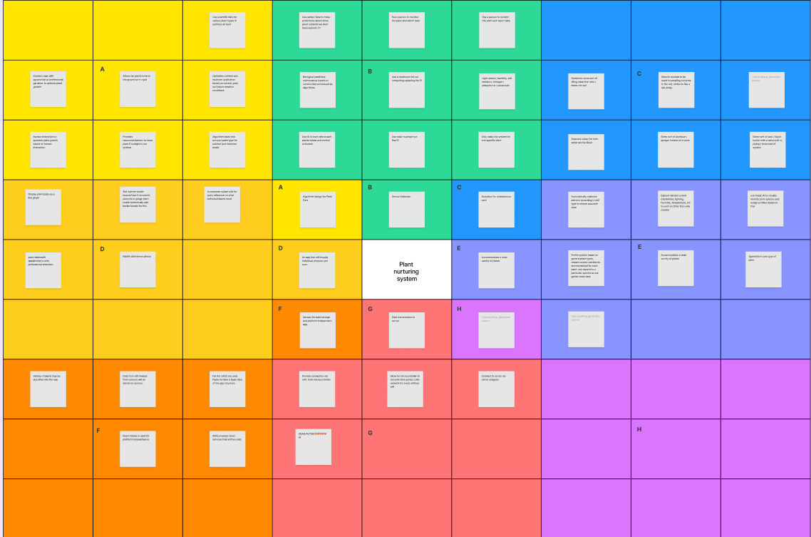
Ideation
Used the lotus blossom technique
Subdivided blossom into seven unique categories:
Data transmission to server
Platforms to host data/app
UX
Algorithm design
How to select sensors
Best method to autowater/fertilize
Accommodating a wide variety of plants

Slide 4
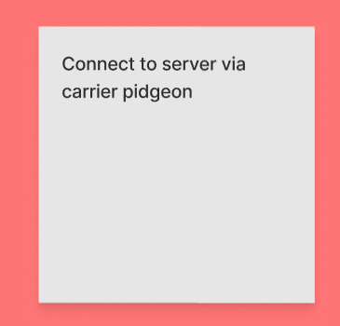
Ideation Cont.
Best ideas:
Incorporate a plant wiki for quick reference on what individual plants need
Use solar to power our device
React Native is used for platform independence.
Provides recommendations to move plant if sunlight is not optimal
Allow for microcontroller to transmit data across LoRa network for areas without wifi

Slide 5
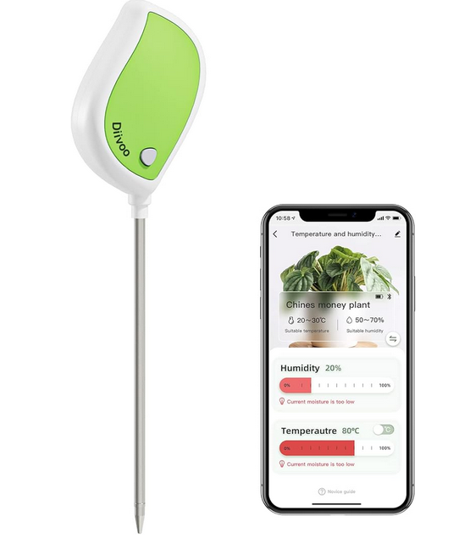

Market Research-Overview
Many similar products on the market
Most other products are low quality low price products
Most other products require manual effort do no other automatization other than showing soil quality

Slide 6
Market Research-Conclusions
An opening on the market exists: A mid price range reliable product
Our automatization options differentiate our product from the competition.
Long term soil data availability is another unique aspect to our project.
Avoid low quality sensors
Aim for reliability many other products fail soon after first use.

